Slide 1
Mathematics Used In My Career
Dr. Carlo Lisi
SENIOR MANGER BUSINESS INSIGHTS AND ANALYTICS

Slide 2
Introduction
Name: Dr. Carlo Lisi
Current Position: Senior Manager, Analytics and Insights
Company: TD Bank
PhD, 1995, Mathematics (C* Algebras and Operator Theory)
University of Toronto, Supervisor: Professor Man Duen Choi
In my current role I focus on:
Performing data analytics for internal audit to support control assessments
Using Advanced analytics(i.e predictive modelling) to test controls, accuracy & completeness of data and fraud assessment
Successful completion of the annual audit plan
Continuous Audit initiative
Risk Intelligence for the Global Audit Team
Robotics Process Automation

Slide 3
Introduction
The main software that are used:
ACL (Audit Command Language – audit specific)
SAS
SQL
R
Python
VBA
Matlab
Computer Programming Skills Required
Experience with the tools above or equivalent data analysis tools

Slide 4
Introduction
Programming skills
From my experience in the current market environment I would recommend some basic programming skills
Microsoft Excel (VBA)
SQL
SAS
R, Python, Julia, Scala, Java Script Apache Spark – other machine learning tools
Hadoop -- Impala, Pig
Data Visualization
Tableau, Spotfire, Qlikview or equivalent

Slide 5
Introduction
Workplace learning
I learned all the listed specialized software and programming languages after being employed
Unix Shell Scripting
ACL
SAS
SQL
Python and R [machine learning packages]
Apache Spark
Tableau
Monarch

Slide 6
Introduction
Mathematics used in Finance
Pricing Derivatives and Exotic Options
Extreme Value Theory
Machine Learning

Slide 7
Introduction
Recommendation for your future professional development
Network with individuals currently engaged in industry and ask for their recommendation
Continue learning programming languages that are used in data analytics & machine learning

Slide 8
MATHEMATICS USED IN MY CAREER
MARKET RISK

Slide 9
Market Risk

Slide 10
Market Risk
My first job at a Financial Institution (Royal Bank of Canada) was Senior Analyst, FX products on the market risk side
Responsible for monitoring Market Risk for FX and commodities in the trading books
Produced VaR (Value at Risk), and the Greeks, i.e. Delta, Gamma, Vega, Rho, and Theta reports
Math Used:
Deterministic calculus – single variable and multi-variable was used to check the calculations done by the Vendor Software (yes, first derivative, second derivatives are used!!)
Stochastic Calculus – for pricing more exotic products (i.e. partial barrier options)
Black-Scholes Option Pricing Formula
Monte-carlo simulation

Slide 11
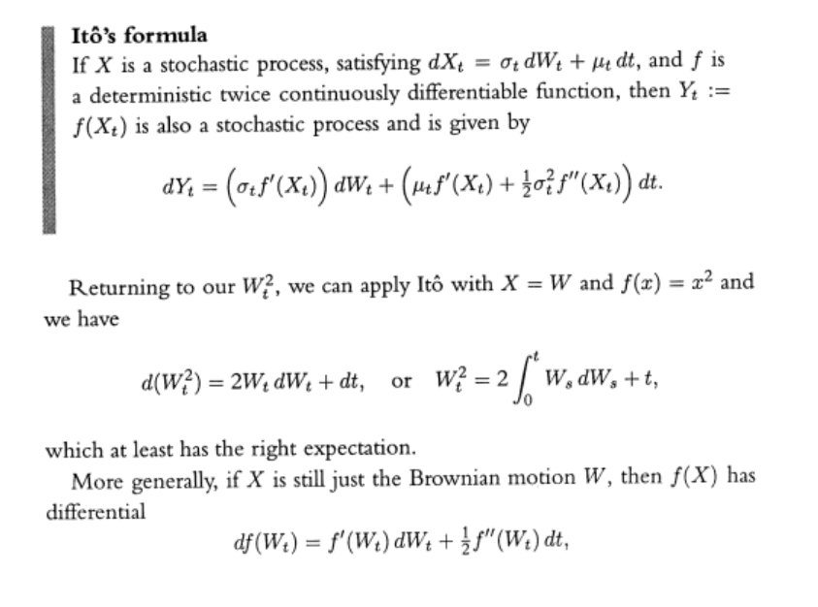
Market Risk
Stochastic calculus

Slide 12
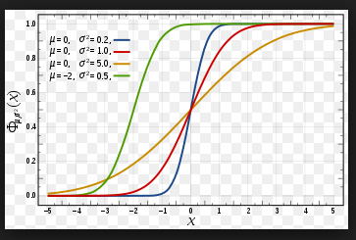
Market Risk
Normal Distribution

Slide 13
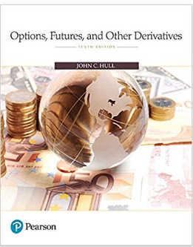
Greeks
DELTA
Change in price of the option with respect to the spot price
To derive this, you need to remember the chain rule, and partial derivatives
Learned financial mathematics from John Hull’s book, “Options, Futures and other Derivatives”
Gamma, Vega, Rho, Theta are all derived in John Hull’s
books

Slide 14
Greeks
The formulas in John Hull’s book or any other academic books all apply in the Capital Markets world
I’ve seen John Hull’s book on the desk of traders, quants and middle office personnel
Software/Programming:
Visual Basic For Applications(VBA) mostly used with MS Excel
Linux shell scripting
Awk , Perl, Python (for parsing data out of scenario files)
OLAP Cubes, extracting data with MDX(Multi-dimensional expressions)
C/C++

Slide 15
Value at Risk

Slide 16
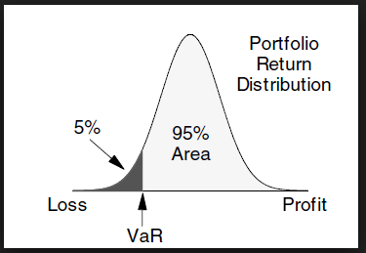
Value at Risk

Slide 17
Normal Distribution (aka, the “Bell Curve”)

Slide 18
Extreme Value Theory

Slide 19
Extreme Value Theory
I used Extreme Value theory to predict the movements in CAD/USD, EUR/USD, JPY/USD exchange rates that could happen over a three-day period once every 15 years
Would use the result to calculate losses in the trading book, if such moves happened
Traders never agreed this could happen, however they had to adhere to the stress limits generated from the EVT scenarios
Code was written in Matlab

Slide 20
MATHEMATICS USED IN MY CAREER
INTERNAL AUDIT

Slide 21
INTERNAL AUDIT
This is where I have used math in my analytics work while working in Internal Audit
Predictive Models , e.g. Scoring of Vendor Invoice and Travel and Entertainment Expenses
Statistical analysis of Risk Measures (Value at Risk, P&L etc…)
Benford’s law & other metrics(NFF, RSF, Levenshtein distance, Fuzzy Matching) to look for fraud / duplication
Sentiment Analysis (used python and R packages – explored the math being used)
Text Analytics (word frequencies, correlations, classification)

Slide 22
LEVENSHTEIN DISTANCE (edit distance)
Minimum Edit distance between two strings str1 and str2 is defined as the minimum number of insert/delete/substitute operations required to transform str1 into str2
For example if str1 = "ab", str2 = "abc" then making an insert operation of character 'c' on str1 transforms str1 into str2
Therefore, edit distance between str1 and str2 is 1
You can also calculate edit distance as number of operations required to transform str2 into str1
For above example, if we perform a delete operation of character 'c' on str2, it is transformed into str1 resulting in same edit distance of 1
Looking at another example, if str1 = "INTENTION" and str2 = "EXECUTION", then the minimum edit distance between str1 and str2 turns out to be 5 as shown below
All operations are performed on str1

Slide 23
LEVENSHTEIN DISTANCE(cont)

Slide 24
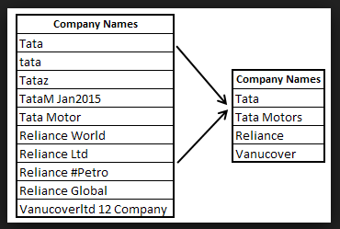
Fuzzy Matching
Fuzzy matching – approximate matching

Slide 25
Fuzzy Matching
Similar_String = 2xLongestCommonSubsequence(String1, String2)
Length(String1) + Length(String2)
Name 1 Name 2 %Match
John Smith Johnny Smith Inc 85.7%
P.O. BOX 201 PO BOX 201 87.0%
55 King Street West 55 King Street W. 86.5%
Exercise: What is the Simil_String similarity between Alpha and AlphaGo?

Slide 26
Number Frequency Factor
Number Frequency Factor is a measure of the level of duplication in a set of Numbers
Formula for NFF = sum(ci^2)/n^2 , i = 1,2..,n
Where ci = number of times a value is repeated, n is the total number of values in the set, ci =0 if a value appears only once
For example, calculate NFF for the set of values below:
S = {1,1,1,4,5,8,8}
Distinct values are 1,4,5,8
1 is repeated three times so c1 is 3^2 (i.e. 3*3)
8 is repeated twice so c8 is 2^2 (i.e. 2*2)

Slide 27
Number Frequency Factor
4 appears only once so c4 = 0
5 appears only once so c5 = 0
n =7 is the number of values in S
NFF = (3^2+2^2)/7^2 = 13/49 which is approximately 0.265
If S = { 1,1,1,1,1,1,1} , NFF = 7^2/7^2 = 1 (all duplicates)
If S = {1,2,3,4,5,6,7} Number , NFF = 0^2/7^2 = 0 (all distinct)

Slide 28
Relative Size Factor(RSF)
The relative size factor (RSF) test is an important error-detecting test.”
Largest Record in a Subset
Relative Size Factor = --------------------------------------------------
Second Largest Record in a Subset
If the largest vendor invoice is a large multiple of the second largest, we would investigate

Slide 29
BENFORD’s LAW

Slide 30
Benford’s Law
Benford’s law is sometimes referred to as digital/frequency analysis
It’s reasonable to expect that the first digit of any value in an dataset (i.e. Vendor Invoices) value to be random
That is , there is an equal chance of the first digit being an number between 1 and 9
But that isn’t necessarily the case
Although it’s counterintuitive, some numbers appear more frequently than others in many datasets
In fact the digit 1is the leading digit 30% of the time, 2 is the leading digit 18% of the time, 3 is the leading digit 12% of the time and larger numbers decreasingly so

Slide 31
Benford’s Law
History of Benford’s Law
In 1881, Simon Newcomb, an astronomer and mathematician, noticed something peculiar
While looking through much-used log tables at the library, he found that earlier pages were more worn than later pages
He concluded that his fellow scientists looked up numbers beginning with the digit one more often than numbers beginning with digit two and so on
He concluded that the probability distribution of the first digit was
P(d) = log10(1+1/d)
Example: P(d=1) = log10(1+1/1 )= log10(2) [get out your calculators]= 0.301029996

Slide 32
Benford’s law
Who is Benford ?
In 1938, physicist Frank Benford, who was unaware of Newcomb’s observation, also discovered same phenomena with his Logarithm Book used by scientists & engineers
Unlike Newcomb, Benford attempted to test his theory with empirical data
Frank Benford analyzed 20,229 data sets by hand(no MS Excel back then)

Slide 33
Benford’s law
Examples:
Baseball statistics
Areas of rivers
Molecular weights of atoms
Electricity bills
Stock market quotes
Populations of towns
Physical and mathematical constants
He discovered that appearance of each digits (1 – 9) is not equally distributed, instead some digits appear more frequently than others

Slide 34
Benford’s law
How is Benford’s Law possible?
If a data entry begins with the digit 1, it has to double in size (100%) before it begins with the next digit – digit 2
If a data entry begins with the digit 9, it only has to be increased by only 11% in order for the first digit to be digit 1 again
Hence, chances of digit 1 is more likely than digit 9
You will have more smaller numbers than larger numbers
Check out the example in attached Excel worksheet

Slide 35
Benford’s Law
A set of numbers is said to satisfy Benford's law if the leading digit d (d ∈ {1, ..., 9}) occurs with probability

Slide 36
Benford’s Law
Many different types of data sets follow this rule, including the
Number of twitter users by followers
Populations of cities across the USA
Heights of buildings
File sizes on your hard drive
Auditors/Forensic accountants often use Benford’s law to detect fraud
When people “massage numbers” in an attempt to defraud, they tend to use more 8s and 9s as the first digit than expected from Benford’s law

Slide 37
Benford’s Law
State of Arizona vs Wayne James Nelson
Invented or altered numbers are not likely to follow Benford’s law
Human choices are not random
Let’s look at an actual legal case that happened in 1992
State of Arizona vs Wayne James Nelson
In 1993 , Wayne James Nelson was accused of trying to defraud the state of Arizona of two million dollars (USD)
Nelson, wrote 23 cheques to a fictitious vendor in seemingly random amounts
But his plan had a major flaw, his amounts weren’t random enough
In the trial the defendant was accused of issuing cheques to a vendor that did not exist

Slide 38
Benford’s Law
Here are the 23 cheque amounts:
Date | Amount
1992-10-09 | 1927.48
1992-10-09 | 27902.31
1992-10-14 | 86241.9
1992-10-14 | 72117.46
1992-10-14 | 81321.75
1992-10-14 | 97473.96
1992-10-19 | 93249.11
1992-10-19 | 89658.17
1992-10-19 | 87776.89
1992-10-19 | 92105.83
1992-10-19 | 79949.16
1992-10-19 | 87602.93
1992-10-19 | 96879.27
1992-10-19 | 91806.47
1992-10-19 | 84991.67
1992-10-19 | 90831.83
1992-10-19 | 93766.67
1992-10-19 | 88388.72
1992-10-19 | 94639.49
1992-10-19 | 83709.28
1992-10-19 | 96412.21
1992-10-19 | 88432.86
1992-10-19 | 71552.16

Slide 39
Benford’s law
First Digit Analysis

Slide 40
Benford’s law
You can clearly see that the fictitious cheque amounts do not conform to Benford’s law
In the next session, we will do the same frequency with the Zetaphor corporation’s (fictitious corporation) invoice data

Slide 41
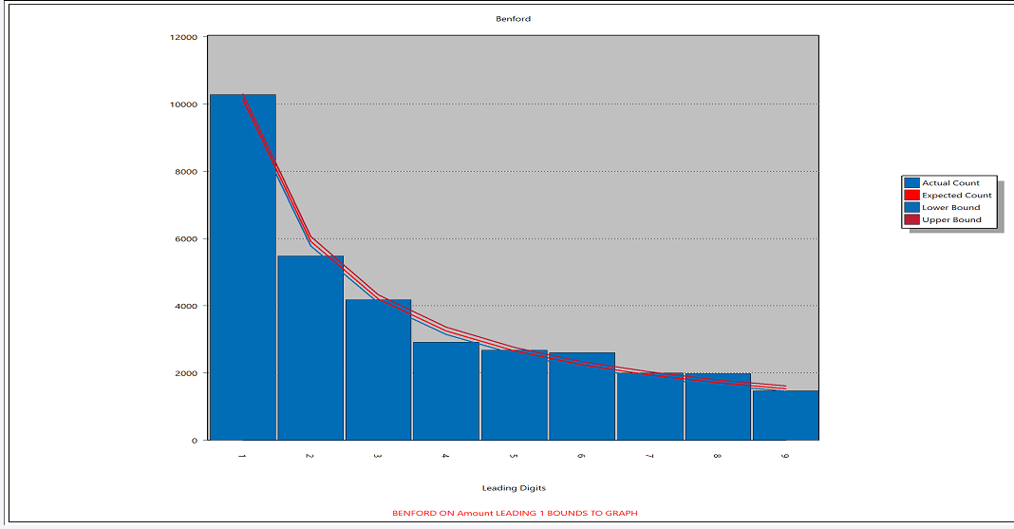
Example -- Vendor Invoices 1st digit
Purchase card transactions

Slide 42
Example – Vendor Invoices first two digits

Slide 43
Benford and Random numbers
Would Benford apply to random numbers?
I generated 10000 random numbers using Excel and here is the plot for the first digit test and first two digits test

Slide 44
Benford and Random Numbers

Slide 45
Benford and Random Numbers
You can see that it doesn’t follow Benford’s law
What I’ll do now is generate 6 sets of 10000 numbers and multiply them together to get one set of random numbers
Let’s do a Benford Analysis on the multiplied random numbers

Slide 46
Benford and Random Numbers

Slide 47
Benford and Random Numbers
What can you observe from this?
It’s that Benford is a “limiting distribution” of digit frequencies

Slide 48
Benford and Random Numbers

